Slide 1
Redefining a web application for the robotics foundation course
Han loo

Slide 2
Overview
The objective of this web app is to provide a platform for the Robotics Foundation students to work on the weekly lab exercises. Users will not have to experience compatibility issues arising from setting up a Robot Operating System development environment

Slide 3
User Stories
As a - Robotics Foundation student
I want - to be able to complete my lab work on an online IDE
So that - I can avoid any issues arising from setting up a development environment on my pc
As a - Robotics Foundation lecturer
I want - an online IDE app for students to complete their lab work
So that - I can save time by not having to look into student development environment setup issues
As a - student considering enrolling into the Robotics Foundation course
I want - to get my hands on robot programming on an easy to use platform
So that - I get a taste of the course before selecting it
As a - Robotics Foundation lab demonstrator
I want - an IDE which the students and I are well familiar with
So that - the students get the most out of their lab sessions

Slide 4
User Stories
As a - Robotics Foundation student
I want - to be able to save my current lab progress to continue later
So that - I don't have to recode my previous work and save time
As a - Robotics Foundation lecturer
I want - a system for which students can submit their lab exercises for grading
So that - I can manage them easily
As a - Robotics Foundation student
I want - an online IDE which works on any OS and browser
So that - I can use my prefered browser + OS and do my weekly lab exercise
As a - Robotics Foundation student
I want - the ability to chat with my peers
So that - I can provide and receive help outside lab hours

Slide 5

Persona 1
Robert is a student enrolled in the Robotics Foundation Course at the University of Glasgow. He wants to work on his weekly lab exercise to improve his understanding and apply concepts taught during the lecture. Due to storage constraints, he does not want to install a linux distro for the sole purpose of completing lab exercise.

Slide 6
Specifications
User types
Robotics Foundation Student
Robotics Foundation Lecturer
Robotics Foundation Lab Demonstrator

Slide 7
Specifications
Users must be able to create an account and log in
Users must be able to select the lab exercises they wish to work on
Users must be able to save their current lab progress
Users must be able to view all past lecture slides
Users could be able to view the lab grades (if graded)
Users could be able to sign in through moodle api integration
Users should be able to resize the windows in the IDE page

Slide 8
System Architecture Diagram
External services - Moodle, OneDrive Business, Gazebo, Rviz, Jupyter notebook
Client - Bootstrap
Middleware - Django
Remote Database - Firebase (maybe)
Three Tier Architecture: where the client handle the interaction with the user, the middleware handles the application logic, and the database stores the data
Most communications are both ways, where a request is made, followed by a response
External services represent applications or services used by the web application, they provide an API or interface which can be used to interact with the service

Slide 9
Reasons for using said services
Bootstrap - provides a consistent UI while also saving time and being highly customisable
Django - extensive documentation with security and scalability
Firebase - provides authentication
Gazebo - Real world robot simulator, sets up a world and moves the robot around
Rviz - visualisation software, allows users to view the Gazebo data

Slide 10
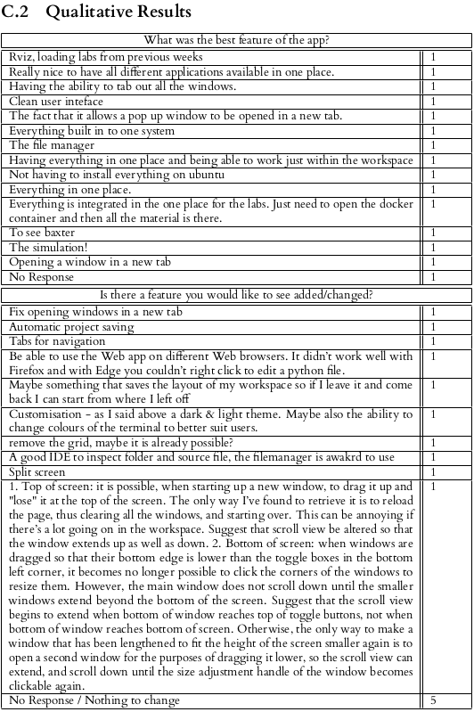
Feedback on the existing app

Slide 11
Feedback on the existing web app

Slide 12
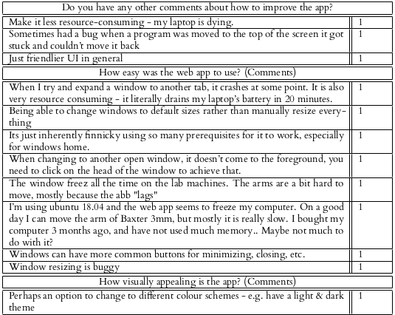
Feedback on the existing

Slide 13
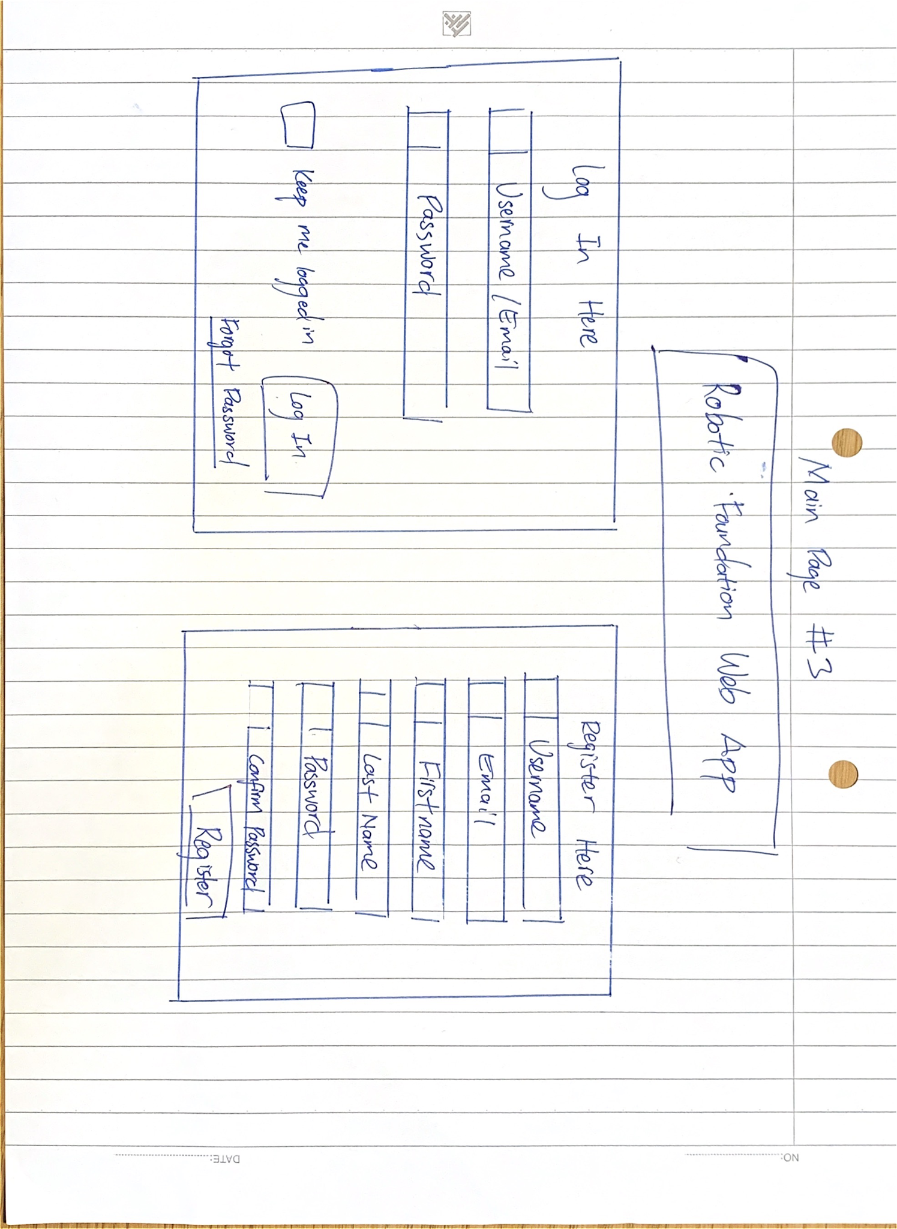
Wireframes

Slide 14
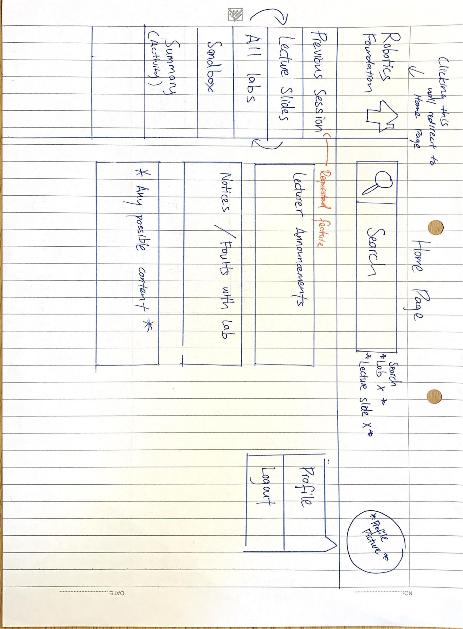
Wireframes

Slide 15
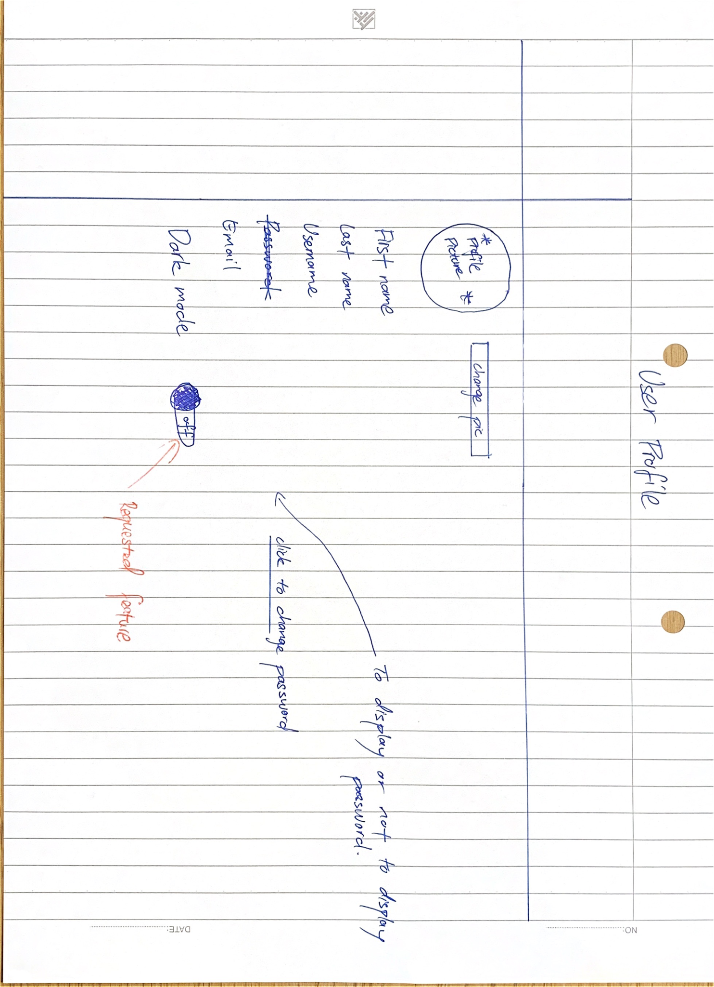
Wireframes

Slide 16
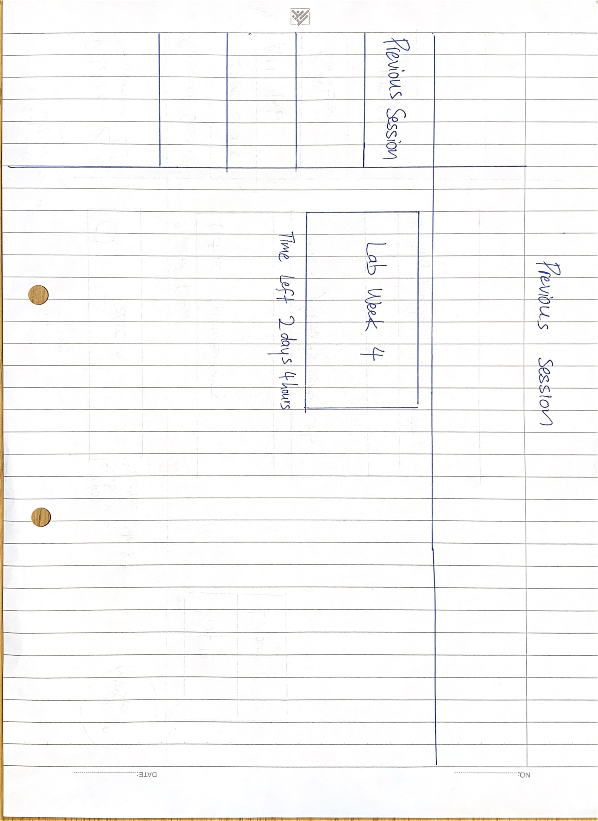
Wireframes

Slide 17
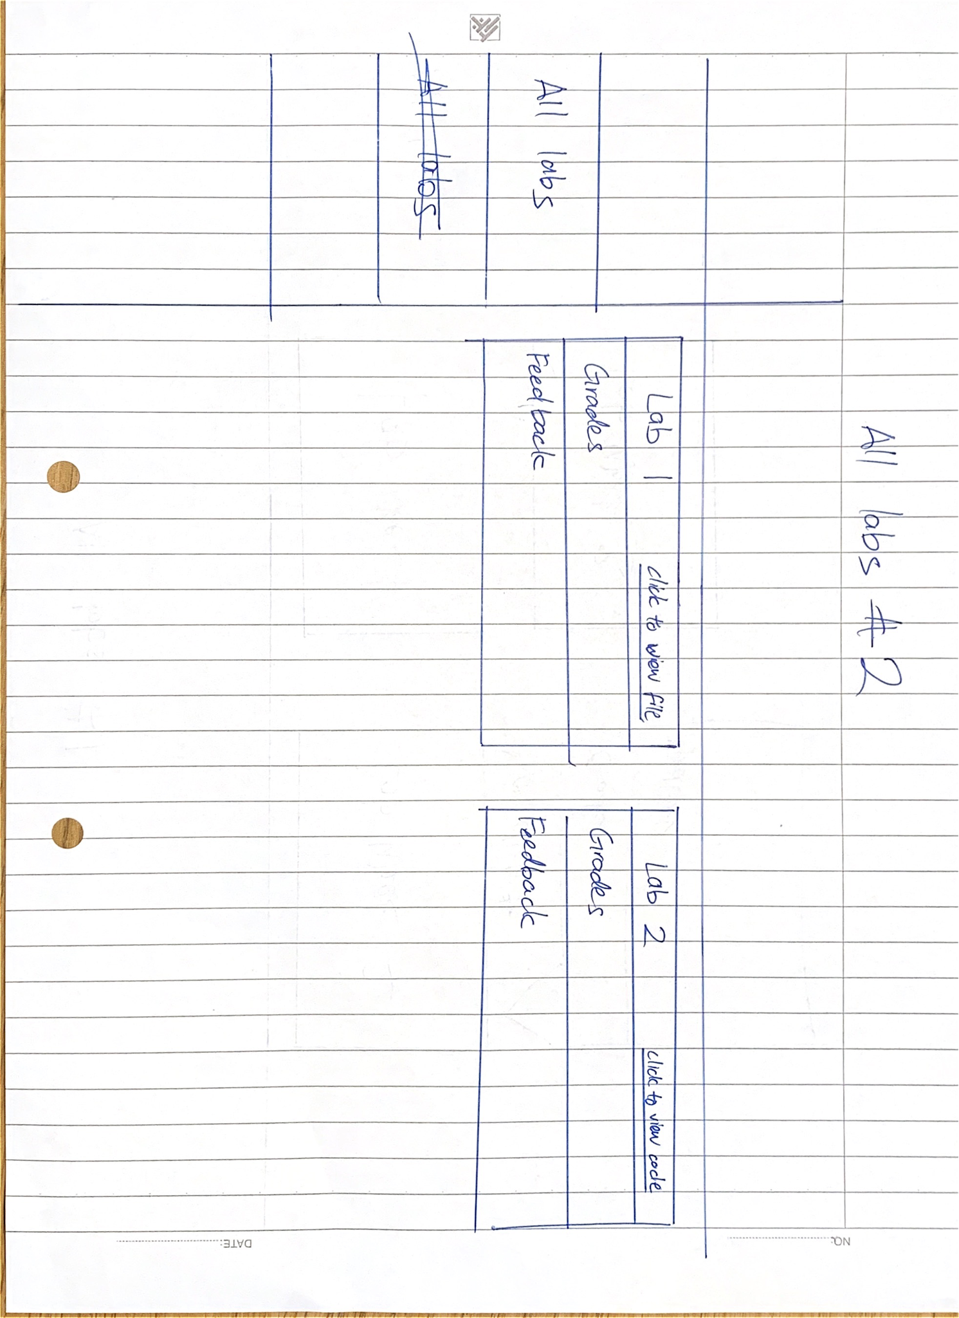
Wireframes

Slide 18
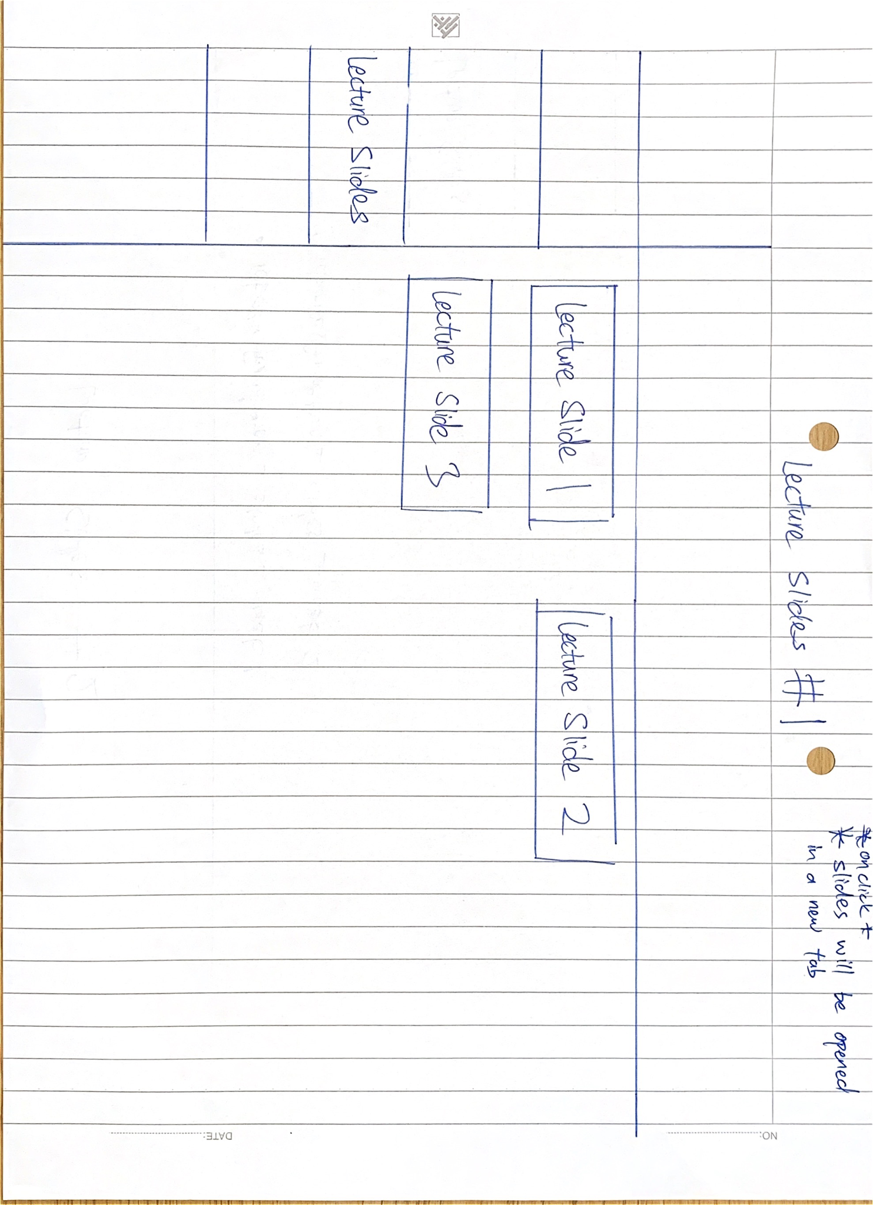
Wireframes

Slide 19
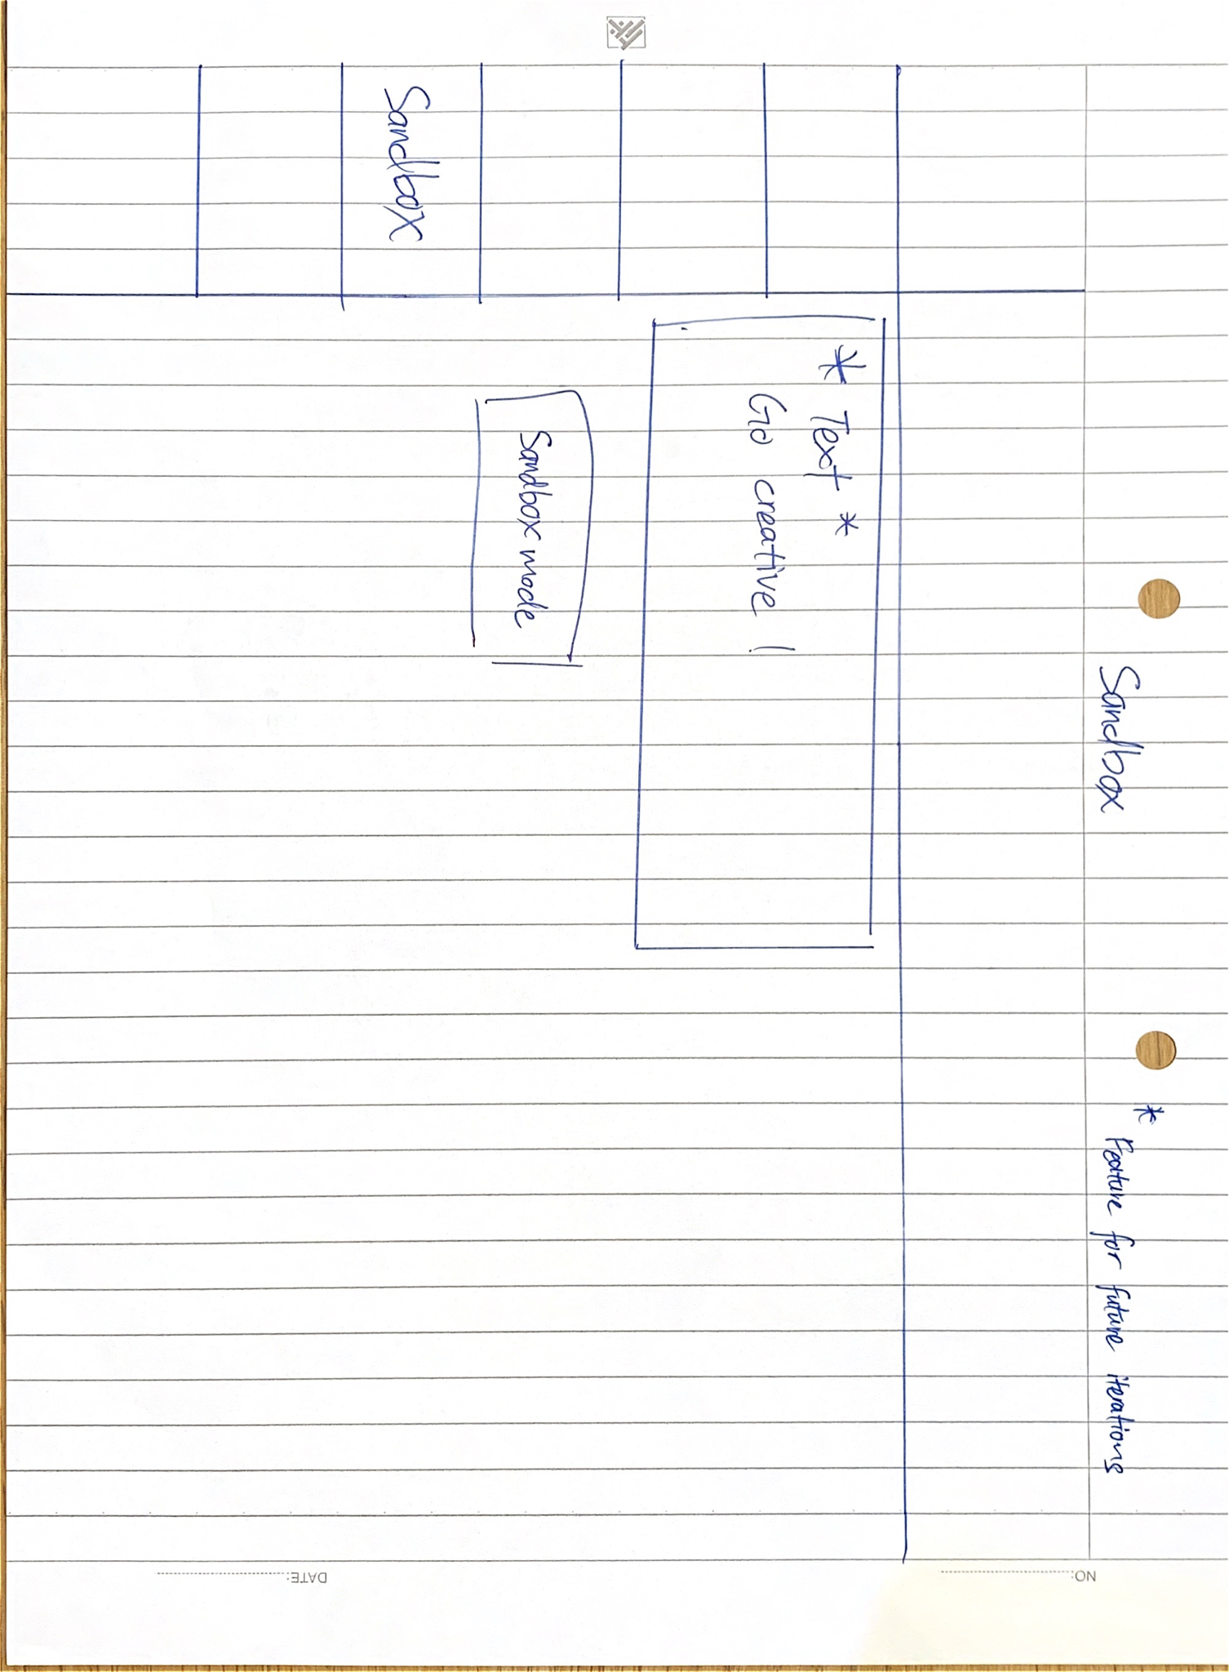
Wireframes

Slide 20
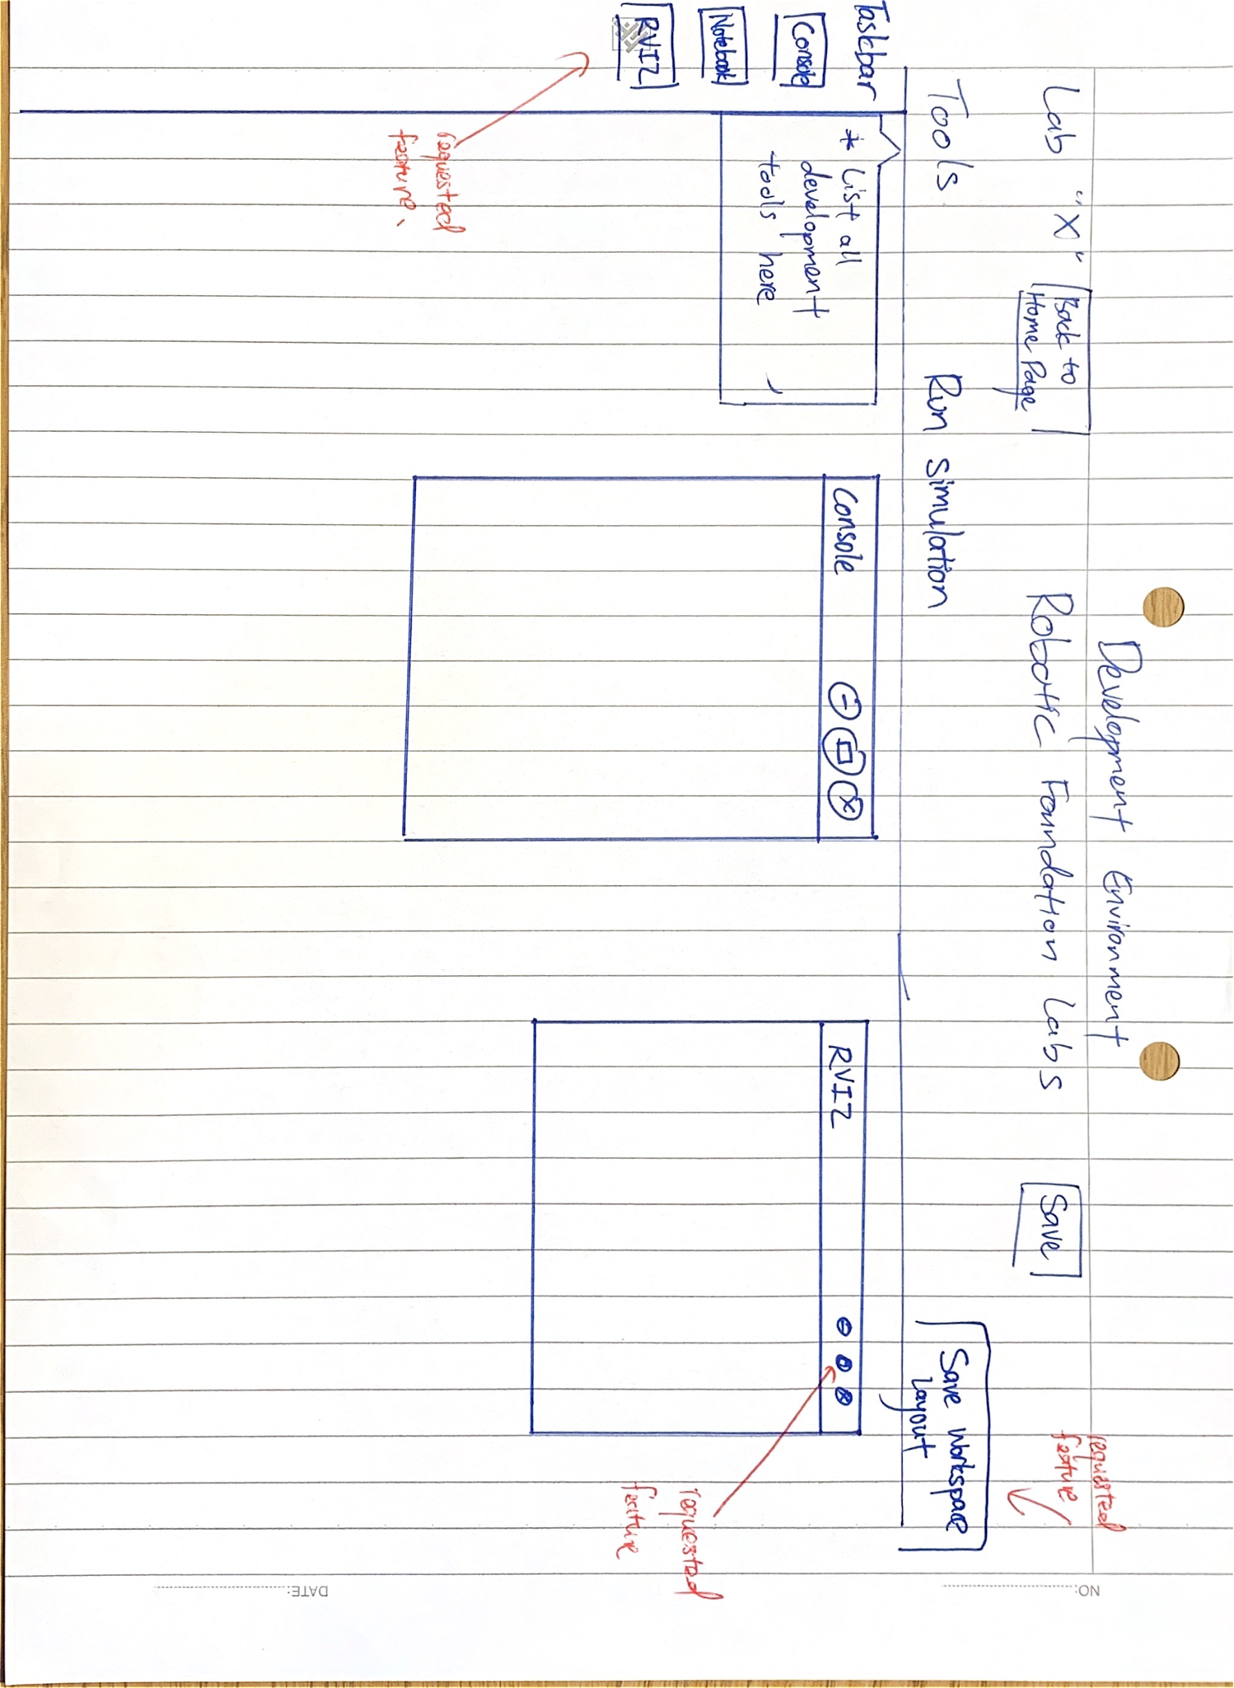
Wireframes

Slide 21
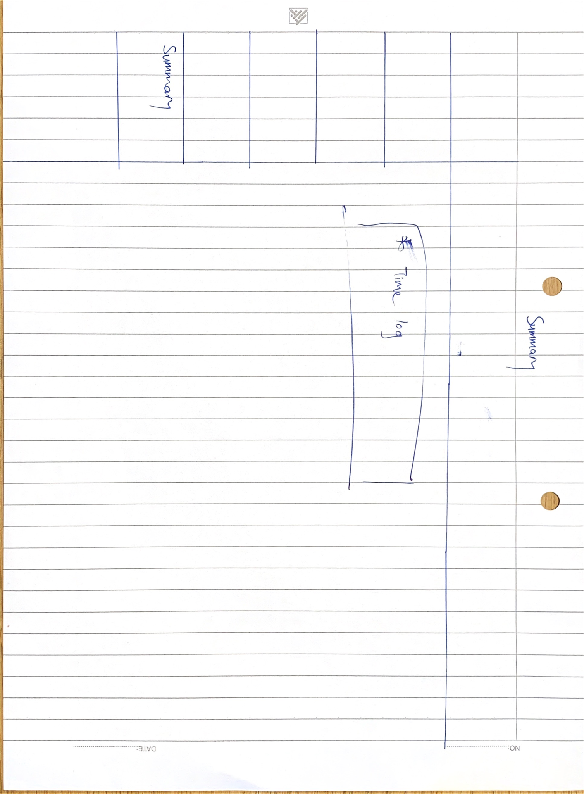
Wireframes

Slide 22
ER Diagram
User
First name Last name Email address Password Student ID Profile picture
Lab exercises
Lab week Time left Grades Feedback Previous saved session
ATTEMPTS
MANY TO MANY
Settings
Dark theme Rviz window size Gazebo window size Rviz window positioning Gazebo window positioning Jupyter notebook size Jupyter notebook positioning
1 to 1
BASED ON
1 to 1
HAS
Lecture slides
Lecture week Page length Additional remarks

Slide 23
Site Map
Login / Create Account
Home Page
Previous session
All labs
Lecture Slides
Sandbox
Summary
Lab 3
Lecture Slide 3
My profile
About us

Slide 24
Site URLs
/login
/home
/previoussession
/alllabs
/lectureslides
/sandbox
/summary
/aboutus

Slide 25
Top Down Design Approach
Using top down design approach is useful because
it is helps describe the system at a level which makes the goals, scope and responsibilities clear
permits the specific technologies to be chosen late or to be changed
the abstraction provides a tool for communicating the design
maintenance and re-usability also profit

